Slide 1



Preparing and QC of sequence data
Including sequence file formats

Slide 2

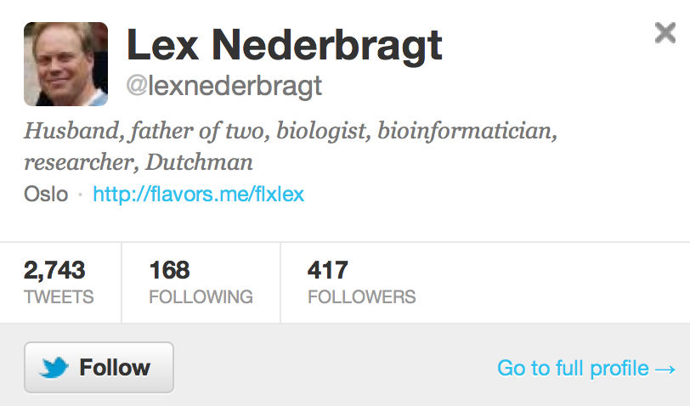
whoami
@lexnederbragt

Slide 3

What do you get?

Slide 4
Single end
Default single end sequencing
Special protocols for mate-pairs

Slide 5
Formats
sff (454)
fasta + qual
fastq

Slide 6
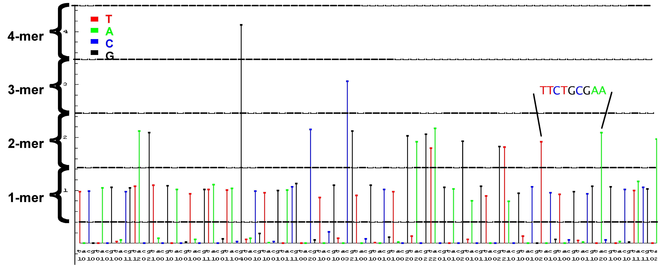
Datafiles 454
sff file (standard flowgram format)
binary
fasta & qual
text

Slide 7
454: sff file (text format)
>F7K88GK01BMPI0
Run Prefix: R_2009_12_18_15_27_42_
Region #: 1
XY Location: 0551_2346
Run Name: R_2009_12_18_15_27_42_FLX########_Administrator_yourrunname
Analysis Name: D_2009_12_19_01_11_43_XX_fullProcessing
Full Path: /data/R_2009_12_18_15_27_42_FLX########_Administrator_yourrunname/D_2009_12_19_01_11_43_XX_fullProcessing/
Read Header Len: 32
Name Length: 14
# of Bases: 500
Clip Qual Left: 15
Clip Qual Right: 490
Clip Adap Left: 0
Clip Adap Right: 0
Flowgram: 1.03 0.00 1.01 0.02 0.00 0.96 0.00 1.00 0.00 1.04 0.00 0.00 0.97 0.00 0.96 0.02 0.00 1.04 0.01 1.04 0.00 0.97 0.96 0.02 0.00 1.00 0.95 1.04 0.00 0.00 2.04 0.02 0.03 1.05 Flow Indexes: 1 3 6 8 10 13 15 18 20 22 23 26 27 28 31 31 34 35 37 37 37 40 43 45 47 47 47 50 53 53 53 55 58 60 63 66 67 67 67 67 70 71 71 74 74 76 79 82 83 86 86 88 88 91 93 96 97...
Bases: tcagatcagacacgCCACTTTGCTCCCATTTCAGCACCCCACCAAGCACAAGGCTGTCATCCCAATTGGACGGACAGATATGAGGTTAGCATTGGAAACCAATTCAGTCCCTAATTATTCACGACTGAACCCAGCGACAATTGGACATGGATTCATTTTTCAACTTGATTTGTTGTTGTAAAAGCA...
Quality Scores: 40 40 40 40 40 40 40 40 40 40 40 40 40 40 40 40 40 40 38 38 38 40 40 40 39 39 39 40 34 34 34 40 40 40 40 39 26 26 26 26 40 40 40 40 40 40 40 40 40 40 40 40 40 40 40 40 40 40 40 40 ...

Slide 8
454: fasta and qual files
Fasta:
>FTJD6BE02HHD3W length=409 xy=2951_1562 region=2 run=R_2009_04_01_11_28_49_
AGAAAGTCAGCGGCAAATTTGGTTTTAGACGAATTGTCCCTTTGACATAACGACTAAAGG
AGTCAACAGATTTTCGTATAACTTCGTATAATGTATGCTATACGAAGTTATTACGCTATT
...
Qual:
>FTJD6BE02HHD3W length=409 xy=2951_1562 region=2 run=R_2009_04_01_11_28_49_
40 40 39 39 39 40 40 40 40 40 40 40 40 38 31 26 26 16 16 16 20 20 14 14 14 14 27 33 32 35 36 33 36 35 36 38 35 20 20 21 24 24 22 36 39 40 38 38 38 40 40 40 40 40 40 37 37 37 33 33
29 36 38 38 38 38 38 38 38 35 20 21 21 21 31 36 37 40 40 35 37 37 40 40 40 40 40 40 40 40 40 40 40 40 40 40 40 40 40 40 40 40 40
...
Sanger-style Phred scores

Slide 9
Quality scores
Phred-based
http://en.wikipedia.org/wiki/Phred_quality_score
Phred Quality Score | Probability of incorrect base call | Base call accuracy
10 | 1 in 10 | 90 %
20 | 1 in 100 | 99 %
30 | 1 in 1 000 | 99.9 %
40 | 1 in 10 000 | 99.99 %
50 | 1 in 100 000 | 99.999 %

Slide 10
Read length
454 GS FLX+
> 800 bases

Slide 11

What do you get?

Slide 12
Paired-end
Default paired-end sequencing
single end also possible
150– 600 bases

Slide 13
Illumina: fastq file
@PCUS-319-EAS487_0004_FC:6:1:1351:952#0/1
CCAACATAGCTGGATGCCAACATAGCTGGATTGTTATAGCTGGTTTGCTTTTCTAACTCGCTGGAAGTTTATAAGCATTCCTACTATTTCATAGTATTAC
+PCUS-319-EAS487_0004_FC:6:1:1351:952#0/1
BBbfYcbV^BV`cQffaBZfB_fdfUYaa]`adcbfef\acfd^cad^fOabRceb`beSbdfaad_e^^dbeedTbd`V\ecdfffYBddb^fa\d\de

Slide 14
Illumina: fastq file
@PCUS-319-EAS487_0004_FC:6:1:1351:952#0/1
CCAACATAGCTGGATGCCAACATAGCTGGATTGTTATAGCTGGTTTGCTTTTCTAACTCGCTGGAAGTTTATAAGCATTCCTACTATTTCATAGTATTAC
+PCUS-319-EAS487_0004_FC:6:1:1351:952#0/1
BBbfYcbV^BV`cQffaBZfB_fdfUYaa]`adcbfef\acfd^cad^fOabRceb`beSbdfaad_e^^dbeedTbd`V\ecdfffYBddb^fa\d\de
Sequence
Quality

Slide 15
Illumina: fastq file
@PCUS-319-EAS487_0004_FC:6:1:1351:952#0/1
CCAACATAGCTGGATGCCAACATAGCTGGATTGTTATAGCTGGTTTGCTTTTCTAACTCGCTGGAAGTTTATAAGCATTCCTACTATTTCATAGTATTAC
+PCUS-319-EAS487_0004_FC:6:1:1351:952#0/1
BBbfYcbV^BV`cQffaBZfB_fdfUYaa]`adcbfef\acfd^cad^fOabRceb`beSbdfaad_e^^dbeedTbd`V\ecdfffYBddb^fa\d\de
Quality score as characters:
Phred score = ASCII value -33
'B' is ASCII 66 → Phred 33

Slide 16
Illumina: fastq file
Different schemes
Sanger ASCII = Phred + 33
Illumina 1.3+ ASCII = Phred + 64
Illumina 1.8+ Same as Sanger

Slide 17
Illumina: fastq file
@PCUS-319-EAS487_0004_FC:6:1:1351:952#0/1
CCAACATAGCTGGATGCCAACATAGCTGGATTGTTATAGCTGGTTTGCTTTTCTAACTCGCTGGAAGTTTATAAGCATTCCTACTATTTCATAGTATTAC
+PCUS-319-EAS487_0004_FC:6:1:1351:952#0/1
BBbfYcbV^BV`cQffaBZfB_fdfUYaa]`adcbfef\acfd^cad^fOabRceb`beSbdfaad_e^^dbeedTbd`V\ecdfffYBddb^fa\d\de
Matching pair in the other file:
+@PCUS-319-EAS487_0004_FC:6:1:1351:952#0/2

Slide 18
FastQ formats
Cock PJ et al 2009
The Sanger FASTQ file format for sequences with quality scores, and the Solexa/Illumina FASTQ variants.
Nucleic Acids Res. 2010 Apr;38(6):1767-71.
and
http://en.wikipedia.org/wiki/Fastq

Slide 19
Read length
454 GS FLX Titanium
Illumina HiSeq
> 800 bases
MiSeq: 150 bp, 250 bp

Slide 20
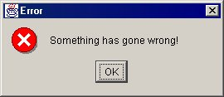
What do you get? Errors!
http://www.it.bton.ac.uk/staff/je/java/jewl/tutorial/tutorial.html

Slide 21
Error profiles
454 GS FLX Titanium
Illumina Genome Analyzer II

Slide 22
Illumina specific
Substitutions
e.g. A→G
Underrepresentation of AT and GC rich regions

Slide 23
454 specific
3 G's? 4 G's?

Slide 24
Duplicate reads
Illumina: PCR step in library prep
454: two beads in one microreactor
emulsion PCR

Slide 25
Solving errors
Oversampling

Slide 26
Oversampling: 454
Undercall
in two reads
Overcall
in three reads
AGAAAGTCAGCGGCAAATTTGGTTTTAGACGAA-TTGTCCCTTTGACATAACGACTAAAGG
AGAAAGTCAGCGGCAAATT-GGTTTTAGACGAA-TTGTCCCTTTGACATAACGACTAAAGG
AGAAAGTCAGCGGCAAATTTGGTTTTAGACGAAATTGTCCCTTTGACATAACGACTAAAGG
AGAAAGTCAGCGGCAAATTTGGTTTTAGACGAA-TTGTCCCTTTGACATAACGACTAAAGG
AGAAAGTCAGCGGCAAATTTGGTTTTAGACGAA-TTGTCCCTTTGACATAACGACTAAAGG
AGAAAGTCAGCGGCAAATTTGGTTTTAGACGAAATTGTCCCTTTGACATAACGACTAAAGG
AGAAAGTCAGCGGCAAATTTGGTTTTAGACGAA-TTGTCCCTTTGACATAACGACTAAAGG
AGAAAGTCAGCGGCAAATTTGGTTTTAGACGAAATTGTCCCTTTGACATAACGACTAAAGG
AGAAAGTCAGCGGCAAATT-GGTTTTAGACGAA-TTGTCCCTTTGACATAACGACTAAAGG
AGAAAGTCAGCGGCAAATTTGGTTTTAGACGAAATTGTCCCTTTGACATAACGACTAAAGG
AGAAAGTCAGCGGCAAATTTGGTTTTAGACGAA-TTGTCCCTTTGACATAACGACTAAAGG
AGAAAGTCAGCGGCAAATTTGGTTTTAGACGAA-TTGTCCCTTTGACATAACGACTAAAGG
Consensus

Slide 27

Quality control

Slide 28
Quality Control
454 (and others): Prinseq
Illumina (and others): fastQC, fastQA, etc

Slide 29
Prinseq
http://edwards.sdsu.edu/prinseq_beta
Web-based and stand-alone
Upload
fasta or fastq file
qual file (optional)

Slide 30
Prinseq
Demo
→the 454 GS FLX+ shotgun reads for this course

Slide 31
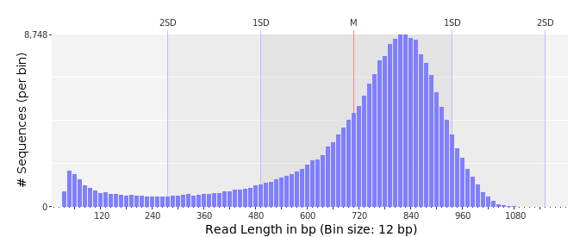
Prinseq: read length

Slide 32
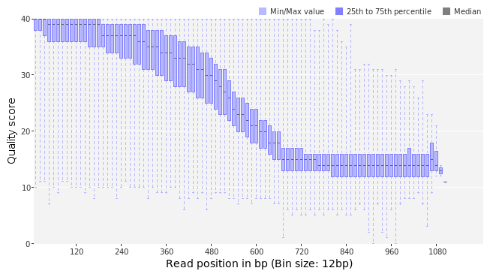
Prinseq: quality per position

Slide 33
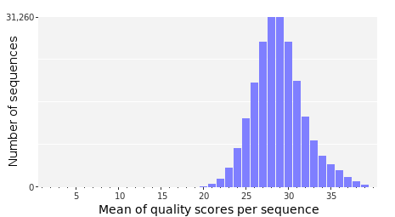
Prinseq: quality values

Slide 34
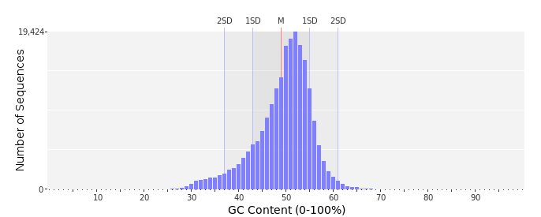
Prinseq: GC content

Slide 35
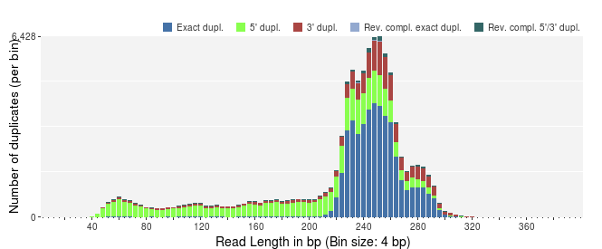
Prinseq: duplicate reads
Expected

Slide 36
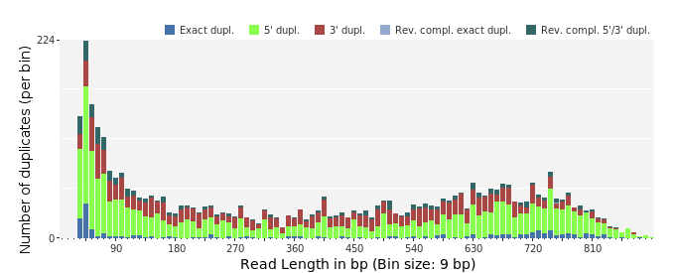
Prinseq: duplicate reads
Observed

Slide 37



Prinseq: adaptors
No tag
Barcode (Roche 'MID')
Transcriptome library adaptor

Slide 38
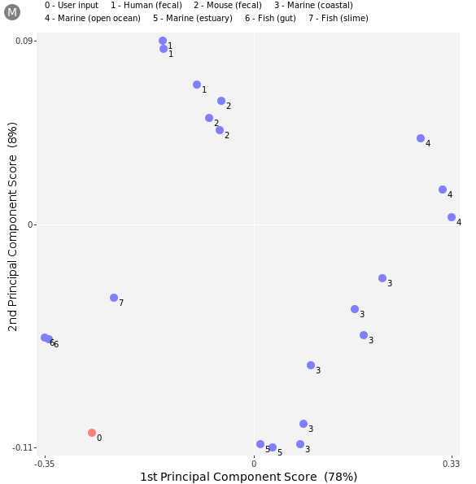
Prinseq: contamination
The dinucleotide
odds ratios*
Principal component analysis (PCA)
*dinucleotide frequencies normalized for the base composition

Slide 39
FastQC
http://www.bioinformatics.bbsrc.ac.uk/projects/fastqc/
Stand-alone
GUI (Java based)
Use
fastq file
BAM/SAM

Slide 40
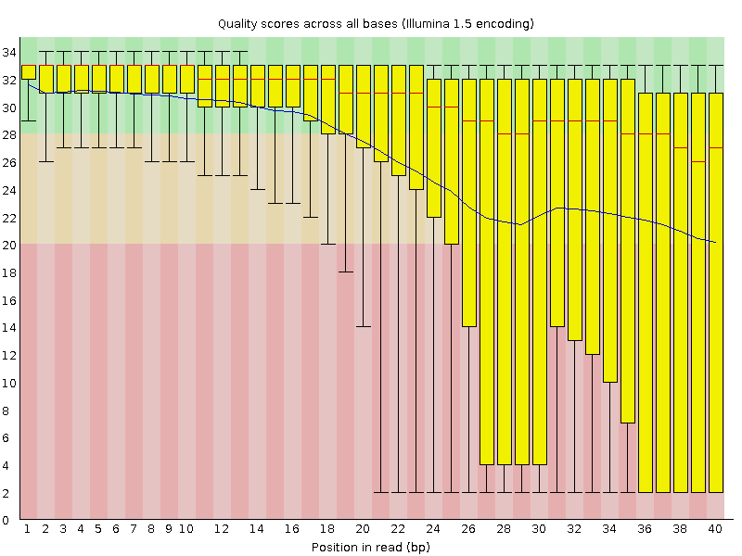
FastQC: quality per position

Slide 41
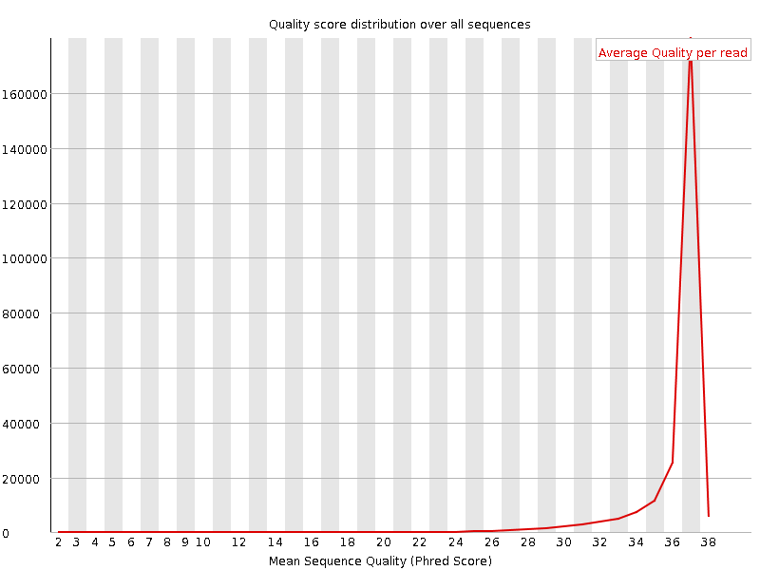
FastQC: quality values

Slide 42
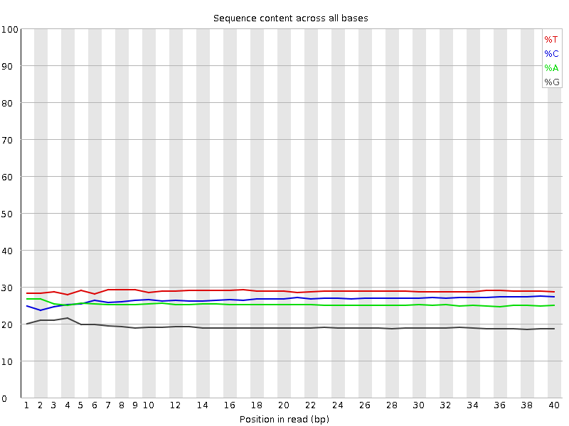
FastQC: nucleotide composition

Slide 43
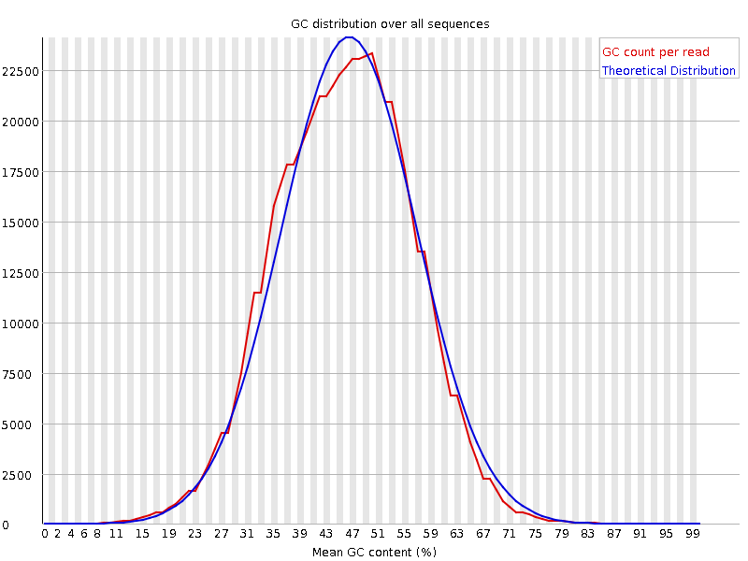
FastQC: GC distribution

Slide 44
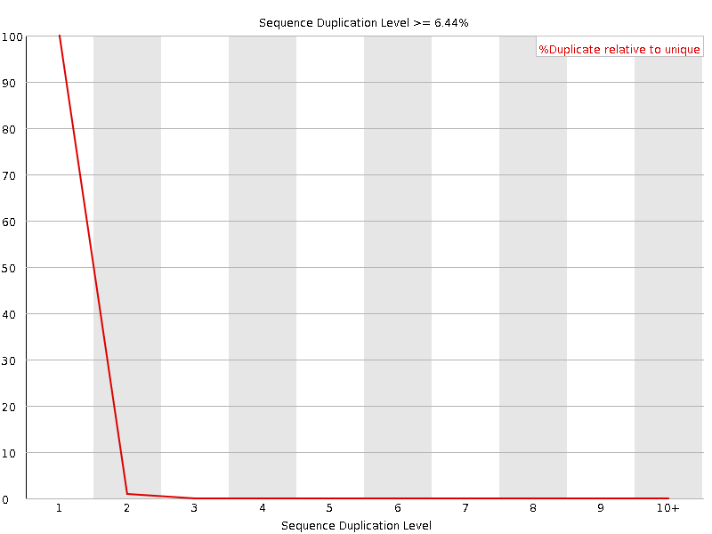
FastQC: duplicated reads

Slide 45
Filtering/trimming
Adaptor removal
especially Illumina
Duplicate removal
Filtering for low quality bases
or stretches of them
reads with 'N's
E.g.
cutadapt
fastX toolkit
prinseq

Slide 46
Practical
FastQC on MiSeq run
Filtering/trimming
Redo FastQC on filtered reads

Slide 47
Learning points
Understand read file formats
How to judge a QC report
How to filter/trim Illumina reads

